Slide 1
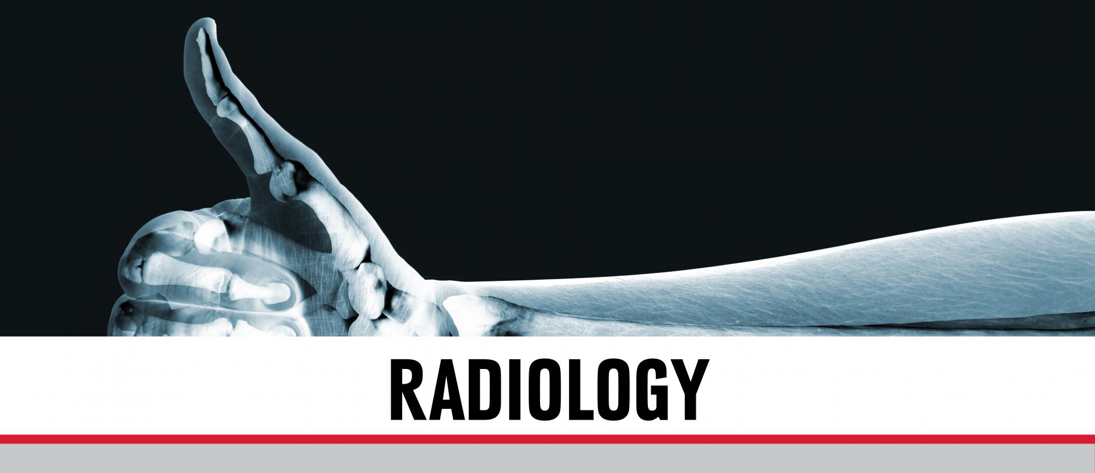
Techno-Aide Coated & Non-Coated Sponges
by: Teresa Quirante RT R.M.
National Sales & Marketing Manager
Nashville, Tennessee USA
1-800-251-2629

Slide 2
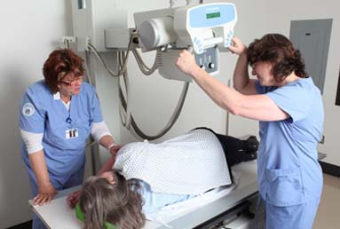
Non-Coated Sponges
Non-Coated sponges are an economical means to help position patients during various radiology examinations. Available in standard and firm composites, they provide the support needed with hard-to-position patients.

Slide 3
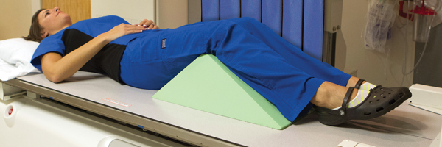
Coated Sponges
Coated sponges are more expensive, but provide a barrier to the foam which allows technologist to clean the surface in between patients. This barrier meets OSHA and Joint Commission Requirements for cleaning and safety for patients.

Slide 4
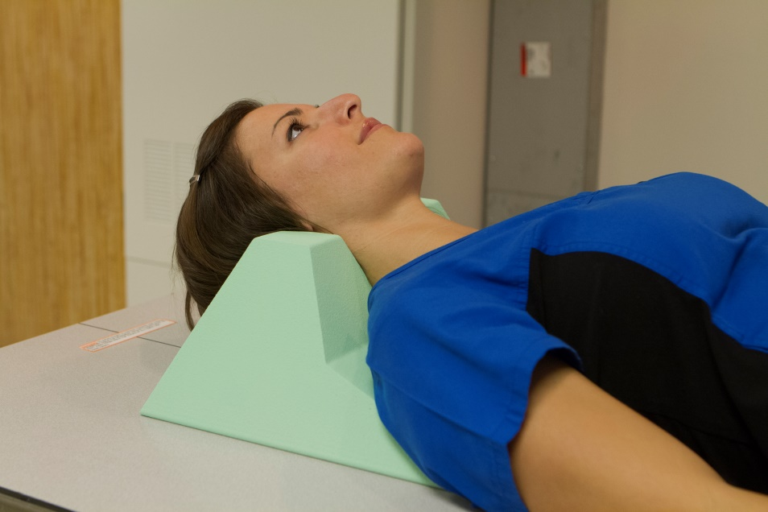
Coated –vs-Non-Coated Sponges
Non-Coated sponges are virtually invisible in the x-ray image. But they don’t provide the cleanable barrier in between patients.
Coated sponges provide the barrier required for cleaning, but do to the additional chemical coating required for this barrier, a ghosting appearance is always present.

Slide 5
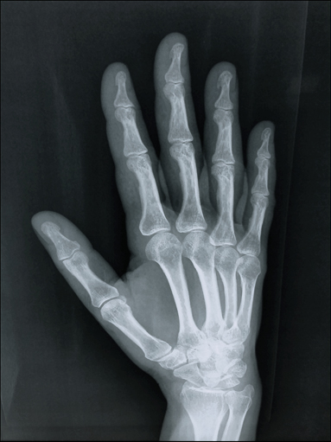
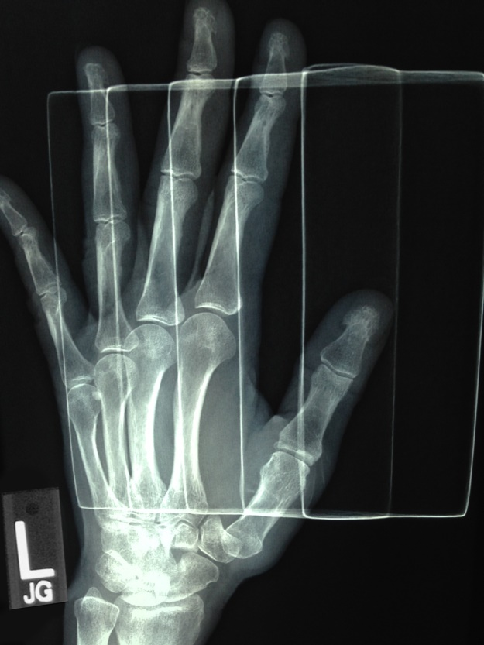
Stealth Sponges
Improved design and patented chemical formulas has made the Techno-Aide Stealth line of sponges the best on the market! Coated sponges have minimal ghosting and no line artifacts like other sponges on the market.
Great image
Unacceptable image
StealthCote
ScanCoat

Slide 6
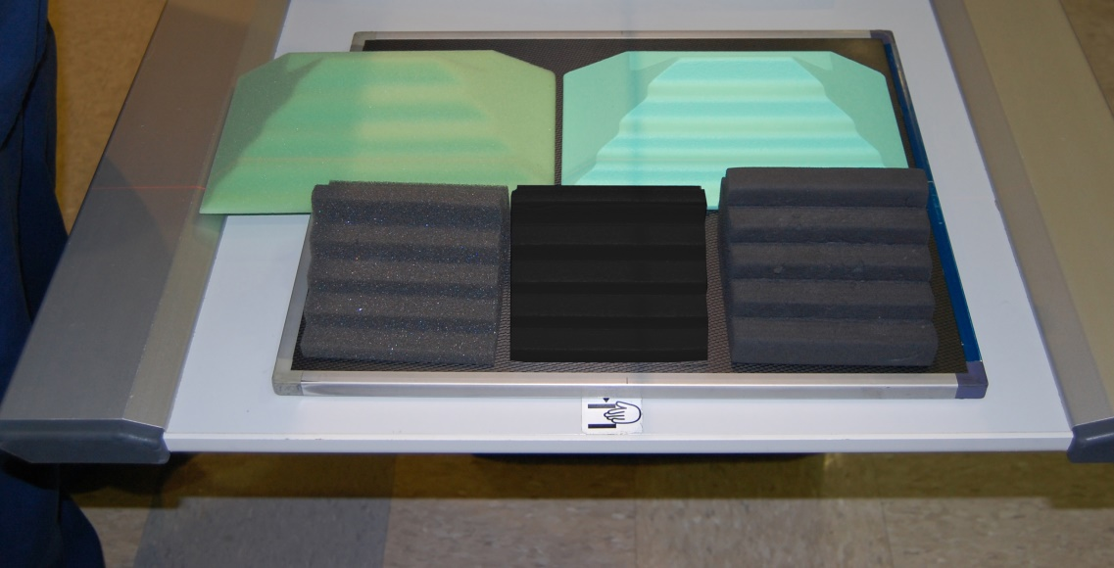
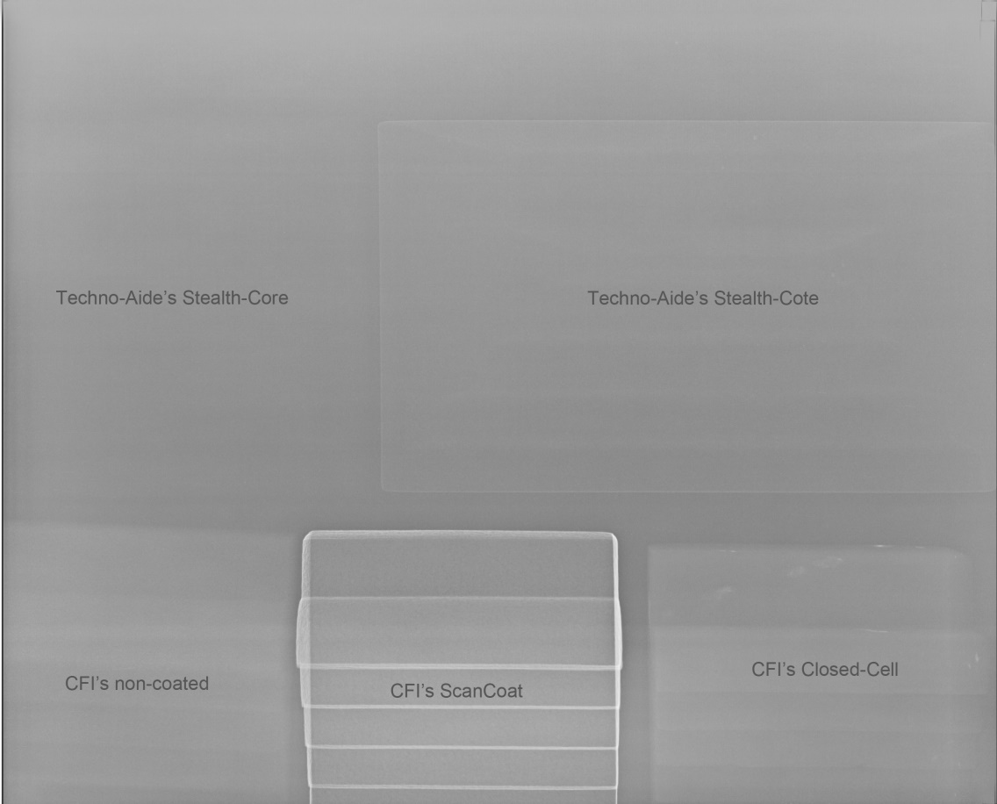
Stealth Sponges
Are images speak for themselves when compared side by side with our competition.

Slide 7
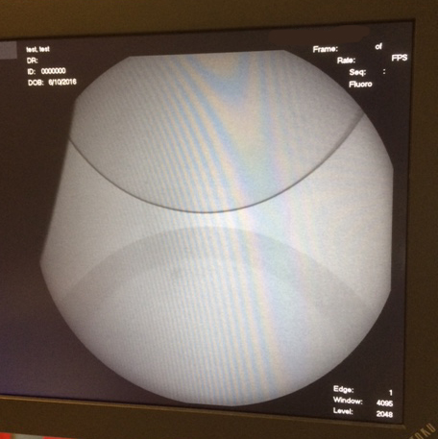
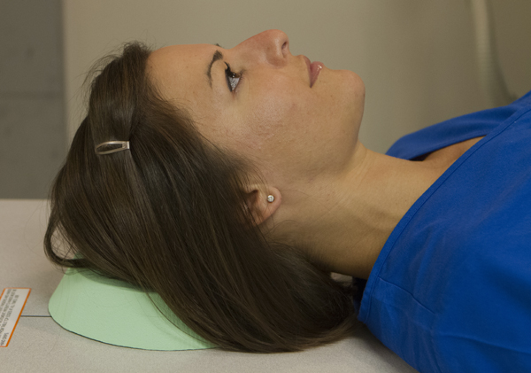
Stealth Cote Sponges
There is a big difference between line artifacts and minimal ghosting. Line artifacts like that seen with ScanCoat are not acceptable! Minimal ghosting does not interfere with interpretation.
ScanCoat
StealthCote

Slide 8
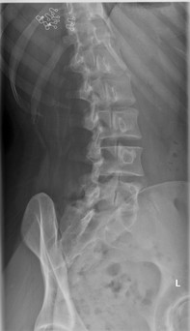
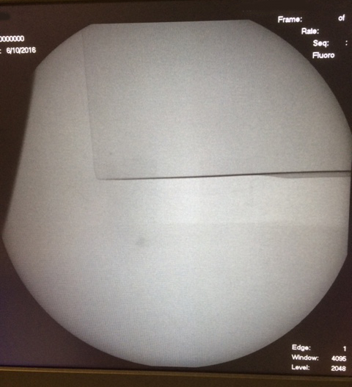
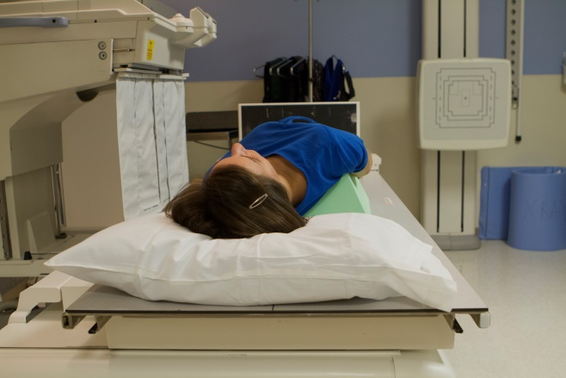
Stealth Sponges
ScanCoat
A Lumbar Oblique using the Stealth Cote 45 degree spinal wedge. Our coated wedge is not seen in the x-ray image under normal radiographic techniques.
StealthCote

Slide 9
DOSE CREEP
Techno-Aide is proud to manufacture the best positioning sponges available anywhere. Our Stealth Sponges exceed expectations in every respect. Their crowning virtue is that they do not appear in the final image, either through heavy ghosting or line artifacts. Prior to the introduction of our Stealth Sponges, coated positioning sponges always appeared as cloudy phantoms in even the best-produced X-ray. Our Stealth Sponges unique composition and corner-free design eliminates this problem when the correct amount of radiation is used. When technologists exceed industry standards of radiation, even the stealthiest sponge can make an appearance on the final image. After a client complaint, we tested it ourselves. Our tests confirmed the extensive research we did when we originally created Stealth Sponges: They are almost invisible in standard diagnostic imaging operations, when industry standard levels of radiation are not exceeded. CLICK HERE to learn more about this….
Perfect!

Slide 10
To see a short clip video on how we manufacture our sponges or to learn more about Techno-Aide’s Stealth Core and Stealth Cote technology, we invite you to visit our website by clicking the link below : Techno-Aide Sponges

